Slide 1
CAP442 Web Technology
Unit I
Session 10
II Year M.C.A

Slide 2
Contents
Cascading Style Sheets(CSS)
CSS Properties
Filters
Transforms
Transitions
Animations

Slide 3
Filters
The filter property defines visual effects (like blur and saturation) to an element (often <img>).
filter: none | blur() | brightness() | contrast() | drop-shadow() | grayscale() | hue-rotate() | invert() | opacity() | saturate() | sepia() | url();
To use multiple filters, separate each filter with a space

Slide 4
<!DOCTYPE html>
<html>
<head>
<style>
img {
filter: grayscale(100%);
}
</style>
</head>
<body>
<h1>The filter Property</h1>
<p>Convert the image to grayscale:</p>
<img src="pineapple.jpg" alt="Pineapple" width="300" height="300">
<p><strong>Note:</strong> The filter property is not supported in Edge 12 or Internet Explorer.</p>
</body>
</html>

Slide 5
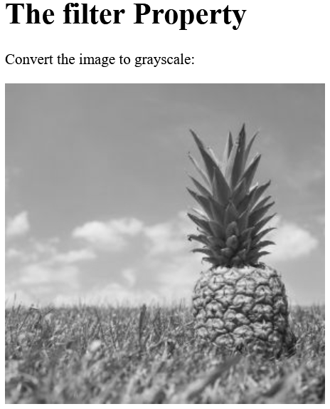

Slide 6
Filter Description
none Default value. Specifies no effects
blur(px) Applies a blur effect to the image. A larger value will create more blur.
If no value is specified, 0 is used.
brightness(%) Adjusts the brightness of the image.
0% will make the image completely black.
100% (1) is default and represents the original image.
Values over 100% will provide brighter results.
contrast(%) Adjusts the contrast of the image.
0% will make the image completely black.
100% (1) is default, and represents the original image.
Values over 100% will provide results with more contrast.

Slide 7
drop-shadow(h-shadow v-shadow blur spread color)
Applies a drop shadow effect to the image.
Possible values:
h-shadow - Required. Specifies a pixel value for the horizontal shadow. Negative values place the shadow to the left of the image.
v-shadow - Required. Specifies a pixel value for the vertical shadow. Negative values place the shadow above the image.
blur - Optional. This is the third value, and must be in pixels. Adds a blur effect to the shadow. A larger value will create more blur (the shadow becomes bigger and lighter). Negative values are not allowed. If no value is specified, 0 is used (the shadow's edge is sharp).

Slide 8
Filter Description
spread - Optional. This is the fourth value, and must be in pixels. Positive values will cause the shadow to expand and grow bigger, and negative values will cause the shadow to shrink. If not specified, it will be 0 (the shadow will be the same size as the element).
color - Optional. Adds a color to the shadow. If not specified, the color depends on the browser (often black).
grayscale(%) Converts the image to grayscale.
0% (0) is default and represents the original image.
100% will make the image completely gray (used for black and white images).
Note: Negative values are not allowed.

Slide 9
Filter Description
hue-rotate(deg) Applies a hue rotation on the image. The value defines the number of degrees around the color circle the image samples will be adjusted. 0deg is default, and represents the original image.
Note: Maximum value is 360deg.
invert(%) Inverts the samples in the image.
0% (0) is default and represents the original image.
100% will make the image completely inverted.
Note: Negative values are not allowed.
opacity(%) Sets the opacity level for the image. The opacity-level describes the transparency-level, where:
0% is completely transparent.
100% (1) is default and represents the original image (no transparency).
Note: Negative values are not allowed.

Slide 10
Filter Description
saturate(%) Saturates the image.
0% (0) will make the image completely un-saturated.
100% is default and represents the original image.
Values over 100% provides super-saturated results.
Note: Negative values are not allowed.
sepia(%) Converts the image to sepia.
0% (0) is default and represents the original image.
100% will make the image completely sepia.
Note: Negative values are not allowed.

Slide 11
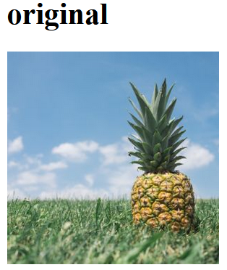
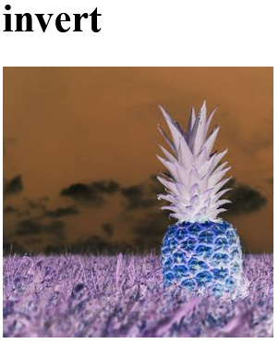
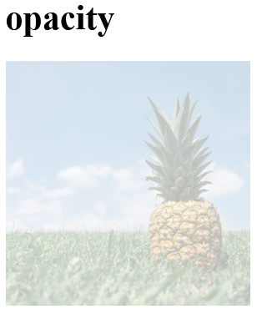
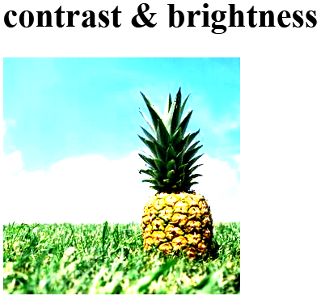
Invert Example
img {
filter: invert(100%);
}
Opacity Example
img {
filter: opacity(30%);
}
Multiple Filters Example
img {
filter: contrast(200%) brightness(150%);
}

Slide 12
Transformation
The transform property applies a 2D or 3D transformation to an element.
This property allows to rotate, scale, move, skew, etc., elements.

Slide 13
Value Description
none Defines that there should be no transformation
matrix(n,n,n,n,n,n) Defines a 2D transformation, using a matrix of six values
matrix3d(n,n,n,n,n,n,n,n,n,n,n,n,n,n,n,n)
Defines a 3D transformation, using a 4x4 matrix of 16 values
translate(x,y) Defines a 2D translation
translate3d(x,y,z) Defines a 3D translation
translateX(x) Defines a translation, using only the value for the X-axis
translateY(y) Defines a translation, using only the value for the Y-axis
translateZ(z) Defines a 3D translation, using only the value for the Z-axis
scale(x,y) Defines a 2D scale transformation
scale3d(x,y,z) Defines a 3D scale transformation
scaleX(x) Defines a scale transformation by giving a value for the X-axis
scaleY(y) Defines a scale transformation by giving a value for the Y-axis
scaleZ(z) Defines a 3D scale transformation by giving a value for the Z-axis

Slide 14
Value Description
rotate(angle) Defines a 2D rotation, the angle is specified in the parameter
rotate3d(x,y,z,angle) Defines a 3D rotation
rotateX(angle) Defines a 3D rotation along the X-axis
rotateY(angle) Defines a 3D rotation along the Y-axis
rotateZ(angle) Defines a 3D rotation along the Z-axis
skew(x-angle,y-angle) Defines a 2D skew transformation along the X- and the Y-axis
skewX(angle) Defines a 2D skew transformation along the X-axis
skewY(angle) Defines a 2D skew transformation along the Y-axis
perspective(n) Defines a perspective view for a 3D transformed element

Slide 15
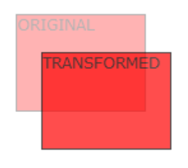
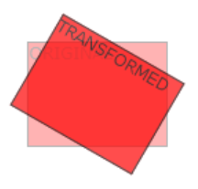
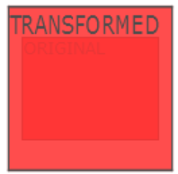
Examples:
div { transform: translate(50px, 100px); }
div { transform: rotate(20deg); }
div { transform: scale(2, 3); }

Slide 16
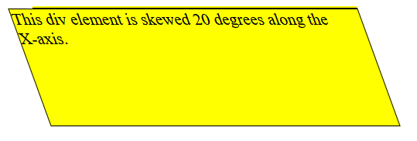
Examples
div {
transform: scaleX(2);
}
div { transform: scaleY(3); }
div { transform: skewX(20deg); }

Slide 17
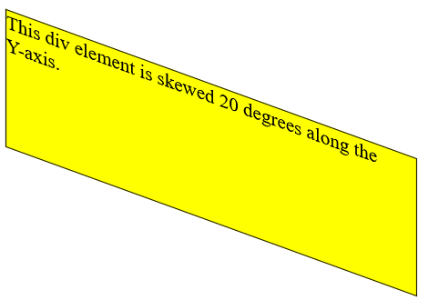
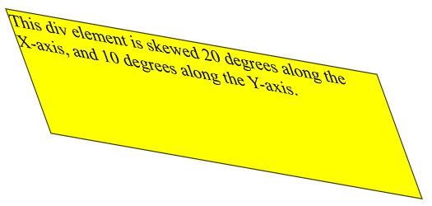
Examples
div { transform: skewY(20deg); }
div { transform: skew(20deg, 10deg); }

Slide 18
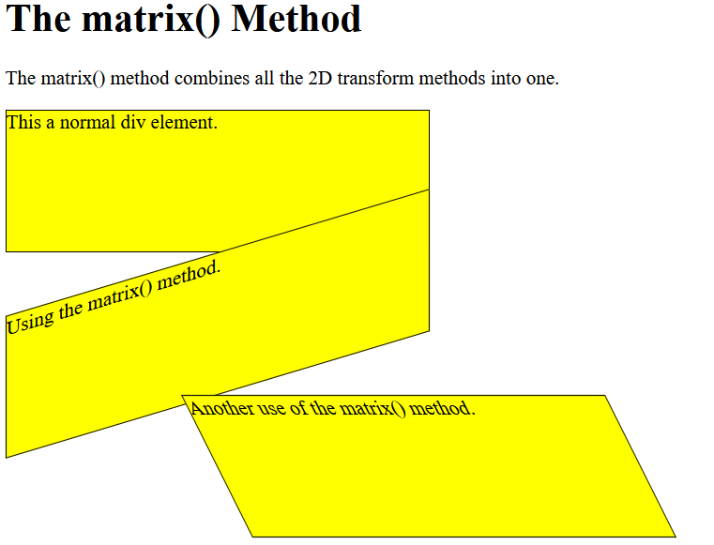
The matrix() method combines all the 2D transform methods into one.
The parameters are as follow: matrix(scaleX(),skewY(),skewX(),scaleY(),translateX(),translateY())
div {
transform: matrix(1, 0, 0.5, 1, 150, 0);
}

Slide 19
Transitions
CSS transitions allows change property values smoothly, over a given duration.
It contains the following properties:
transition-delay
transition-duration
transition-property
transition-timing-function

Slide 20
To create a transition effect, we must specify two things:
the CSS property you want to add an effect to
the duration of the effect
Note: If the duration part is not specified, the transition will have no effect, because the default value is 0.

Slide 21
The following example shows a 100px * 100px red <div> element. The <div> element has also specified a transition effect for the width property, with a duration of 2 seconds:
Example
div {
width: 100px;
height: 100px;
background: red;
transition: width 2s;
}
The transition effect will start when the specified CSS property (width) changes value.
Now, let us specify a new value for the width property when a user mouses over the <div> element:
Example
div:hover {
width: 300px;
}

Slide 22
Change Several Property Values
The following example adds a transition effect for both the width and height property, with a duration of 2 seconds for the width and 4 seconds for the height:
Example
div {
transition: width 2s, height 4s;
}

Slide 23
The transition-timing-function property specifies the speed curve of the transition effect.
The transition-timing-function property can have the following values:
ease - specifies a transition effect with a slow start, then fast, then end slowly (this is default)
linear - specifies a transition effect with the same speed from start to end
ease-in - specifies a transition effect with a slow start
ease-out - specifies a transition effect with a slow end
ease-in-out - specifies a transition effect with a slow start and end
cubic-bezier(n,n,n,n) - lets you define your own values in a cubic-bezier function

Slide 24
The transition-delay property specifies a delay (in seconds) for the transition effect.
The following example has a 1 second delay before starting:
div {
transition-delay: 1s;
}
The following example adds a transition effect to the transformation:
div {
transition: width 2s, height 2s, transform 2s;
}

Slide 25
The CSS transition properties can be specified one by one, like this:
div {
transition-property: width;
transition-duration: 2s;
transition-timing-function: linear;
transition-delay: 1s;
}
or by using the shorthand property transition:
div {
transition: width 2s linear 1s;
}

Slide 26
Animations
CSS allows animation of HTML elements without using JavaScript or Flash!
It has following properties:
@keyframes
animation-name
animation-duration
animation-delay
animation-iteration-count
animation-direction
animation-timing-function
animation-fill-mode

Slide 27
An animation lets an element gradually change from one style to another.
You can change as many CSS properties you want, as many times as you want.
To use CSS animation, you must first specify some keyframes for the animation.
Keyframes hold what styles the element will have at certain times.
The @keyframes Rule
When you specify CSS styles inside the @keyframes rule, the animation will gradually change from the current style to the new style at certain times.
To get an animation to work, you must bind the animation to an element.

Slide 28
The following example binds the "example" animation to the <div> element. The animation will last for 4 seconds, and it will gradually change the background-color of the <div> element from "red" to "yellow":
/* The animation code */
@keyframes example {
from {background-color: red;}
to {background-color: yellow;}
}
/* The element to apply the animation to */
div {
width: 100px;
height: 100px;
background-color: red;
animation-name: example;
animation-duration: 4s;
}

Slide 29
The animation-duration property defines how long an animation should take to complete.
If the animation-duration property is not specified, no animation will occur, because the default value is 0s (0 seconds).
In the example above we have specified when the style will change by using the keywords "from" and "to" (which represents 0% (start) and 100% (complete)).
It is also possible to use percent. By using percent, you can add as many style changes as you like.

Slide 30
The following example will change the background-color of the <div> element when the animation is 25% complete, 50% complete, and again when the animation is 100% complete:
/* The animation code */
@keyframes example {
0% {background-color: red;}
25% {background-color: yellow;}
50% {background-color: blue;}
100% {background-color: green;}
}
/* The element to apply the animation to */
div {
width: 100px;
height: 100px;
background-color: red;
animation-name: example;
animation-duration: 4s;
}

Slide 31
The animation-delay property specifies a delay for the start of an animation.
In delay, negative values are also allowed. If using negative values, the animation will start as if it had already been playing for N seconds.

Slide 32
The animation-iteration-count property specifies the number of times an animation should run.
If the value is "infinite" then the animation continue for ever.

Slide 33
The animation-direction property specifies whether an animation should be played forwards, backwards or in alternate cycles.
The animation-direction property can have the following values:
normal - The animation is played as normal (forwards). This is default
reverse - The animation is played in reverse direction (backwards)
alternate - The animation is played forwards first, then backwards
alternate-reverse - The animation is played backwards first, then forwards

Slide 34
The animation-timing-function property specifies the speed curve of the animation.
The animation-timing-function property can have the following values:
ease - Specifies an animation with a slow start, then fast, then end slowly (this is default)
linear - Specifies an animation with the same speed from start to end
ease-in - Specifies an animation with a slow start
ease-out - Specifies an animation with a slow end
ease-in-out - Specifies an animation with a slow start and end

Slide 35
The animation-fill-mode property specifies a style for the target element when the animation is not playing (before it starts, after it ends, or both).
The animation-fill-mode property can have the following values:
none - Default value. Animation will not apply any styles to the element before or after it is executing
forwards - The element will retain the style values that is set by the last keyframe (depends on animation-direction and animation-iteration-count)
backwards - The element will get the style values that is set by the first keyframe (depends on animation-direction), and retain this during the animation-delay period
both - The animation will follow the rules for both forwards and backwards, extending the animation properties in both directions

Slide 36
Animation Shorthand Property
The animation effect can be achieved by using the shorthand animation property:
div {
animation: example 5s linear 2s infinite alternate;
}

Slide 37
References
https://www.w3schools.com/css/default.asp
https://developer.mozilla.org/en-US/docs/Web/CSS

